Slide 1
PyWorking - Databazy intro
Petr Messner, Peter Varga

Slide 2
Pyworking - co by ste radi?
Konkretny smer vs. “ochutnavka” z viacerych smerov?
Dalsie temy:
Git, Github (group-working na github)
Statistika & Machine learning
Linux
Front end (very light - html, css, bootstrap, javascript)
Hry
Realny projekt - todo, instagram, airbnb (MVP)
React.js
Servery & Cloudy (intro to SysAdmin work)
Networking
Jak funguje internet (peeringove centra, dns, ..)
Ethical hacking (hacknut webovku co urobime)
Mobilni aplikace

Slide 3
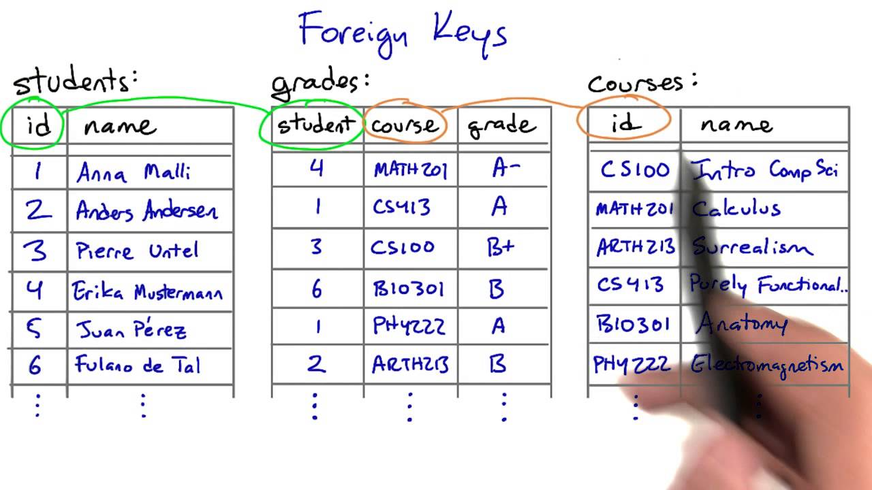
Uvod do relacnych databaz
Notes:
Relacne databazy (v principe system normalizovanych/deduplikovanych “tabuliek” {ala excel} ktore spolu suvisia).
Riadky: jednotlive zaznamy , Stlpce: definicia co tabulka obsahuje. Kazdy stlpec ma datovy typ
Kazda tabulka ma “primarny kluc” ja jednoznacnu identifikaciu riadku
Odkaz na inu tabulku sa robi pomocou “cudieho kluca”

Slide 4
Uvod do SQL
CREATE TABLE (Vytvorenie tabulky)
INSERT (Pridanie zaznamu)
SELECT (Pristup / “precitanie” zaznamu)
UPDATE (Upravenie/aktualizacia zaznamu)
DELETE (Zrusenie zaznamu/Tabulky)
Notes:
Programaticky pristup k tvorbe , zmenam, aktualizacii, zruseniu zaznamu)
Priklady z KhanAcademy SQL course https://www.khanacademy.org/computing/computer-programming/sql/sql-basics/ (can use their sql engine for explaining)

Slide 5
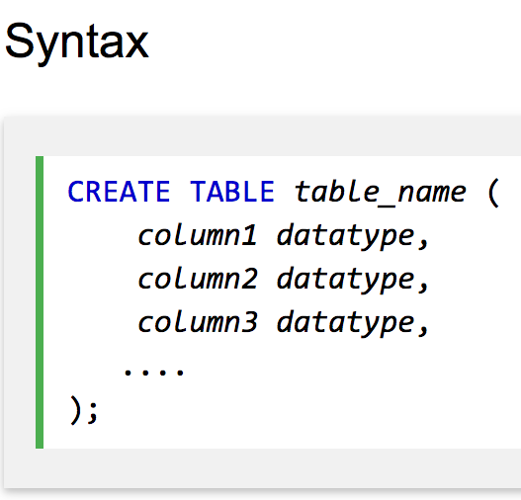
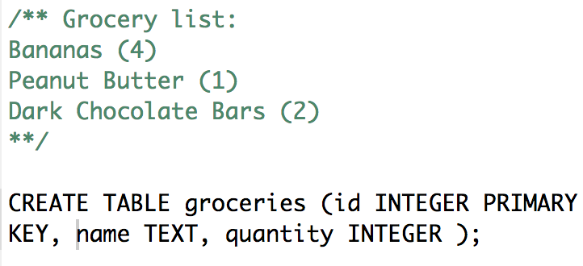
CREATE TABLE
Notes:
CREATE TABLE groceries (id INTEGER PRIMARY KEY, name TEXT, quantity INTEGER );

Slide 6

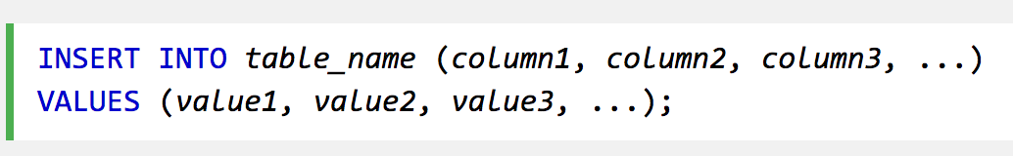
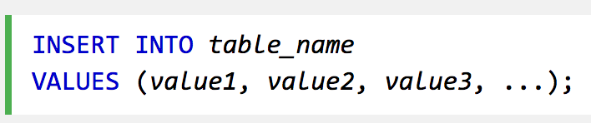
INSERT - syntax
Specifikacia konkretnych stlpcov
B. Vsetky stlpce
Zalezi na poradi!
Notes:
Ked vynecham ID ako stlpec v INSERT, tak si to databaze sama vlozi (doporucene nepouzivat ID!)

Slide 7
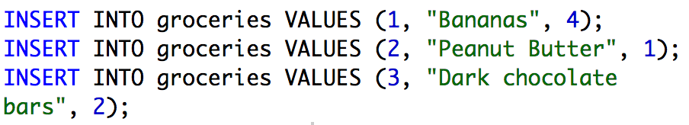
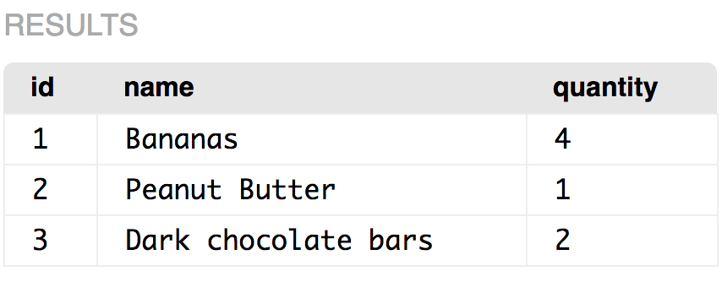
INSERT - priklad
Notes:
SQL:
INSERT INTO groceries VALUES (1, "Bananas", 4);
INSERT INTO groceries VALUES (2, "Peanut Butter", 1);
INSERT INTO groceries VALUES (3, "Dark chocolate bars", 2);
// INSERT INTO groceries (name, quantity) VALUES ("Dark chocolate bars", 2) // samo si doplni ID
SELECT * FROM groceries;

Slide 8
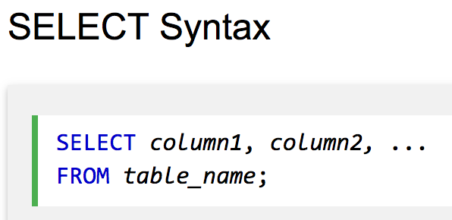

SELECT - Syntax
Specifikacia konkretnych stlpcov
B. Vsetky stlpce ( * )

Slide 9

SELECT - priklad

Slide 10
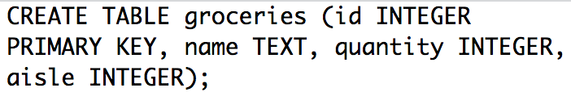
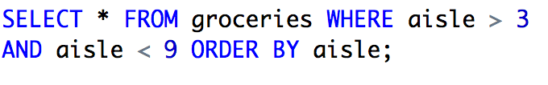
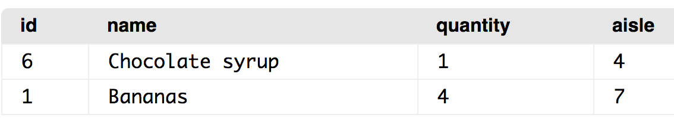
SELECT - WHERE, AND/OR, ORDER BY
Notes:
SQL:
CREATE TABLE groceries (id INTEGER PRIMARY KEY, name TEXT, quantity INTEGER, aisle INTEGER);
INSERT INTO groceries VALUES (1, "Bananas", 4, 7);
INSERT INTO groceries VALUES(2, "Peanut Butter", 1, 2);
INSERT INTO groceries VALUES(3, "Dark Chocolate Bars", 2, 2);
INSERT INTO groceries VALUES(4, "Ice cream", 1, 12);
INSERT INTO groceries VALUES(5, "Cherries", 6, 2);
INSERT INTO groceries VALUES(6, "Chocolate syrup", 1, 4);
Priklad (speaker notes):
Ukazat po jednotlivych novych prikazoch (WHERE, AND/OR, ORDER BY)
Ukazat ze where a order by nemusi byt to iste

Slide 11
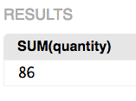
SELECT - AGGREGATE FUNCTIONS
(SUM, COUNT, MAX, MIN..)

Slide 12
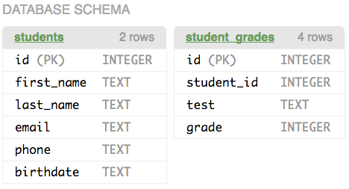
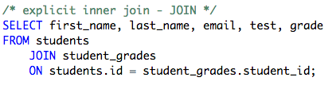
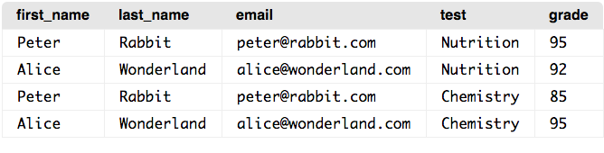
SELECT - JOIN
Chcem meno, priezvisko, email, test a grade v JEDNEJ TABULKE
Notes:
SQL:
CREATE TABLE students (id INTEGER PRIMARY KEY,
first_name TEXT,
last_name TEXT,
email TEXT,
phone TEXT,
birthdate TEXT);
INSERT INTO students (first_name, last_name, email, phone, birthdate)
VALUES ("Peter", "Rabbit", "peter@rabbit.com", "555-6666", "2002-06-24");
INSERT INTO students (first_name, last_name, email, phone, birthdate)
VALUES ("Alice", "Wonderland", "alice@wonderland.com", "555-4444", "2002-07-04");
CREATE TABLE student_grades (id INTEGER PRIMARY KEY,
student_id INTEGER,
test TEXT,
grade INTEGER);
INSERT INTO student_grades (student_id, test, grade)
VALUES (1, "Nutrition", 95);
INSERT INTO student_grades (student_id, test, grade)
VALUES (2, "Nutrition", 92);
INSERT INTO student_grades (student_id, test, grade)
VALUES (1, "Chemistry", 85);
INSERT INTO student_grades (student_id, test, grade)
VALUES (2, "Chemistry", 95);
SELECT * FROM student_grades;

Slide 13
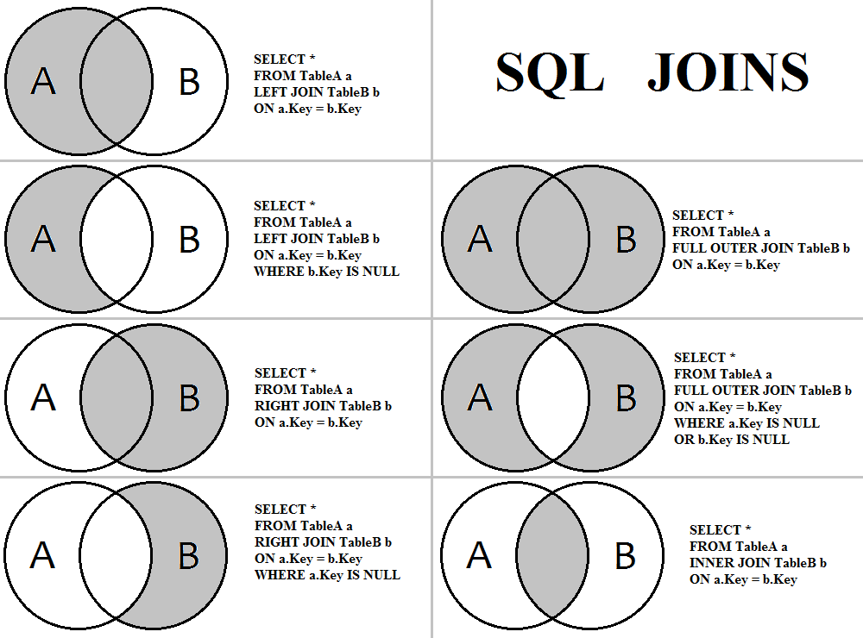
Notes:
Priklad:
Student, co nema znamku a ukazat rozdiel medzi left join, inner join

Slide 14
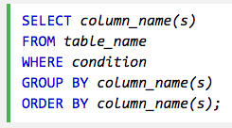
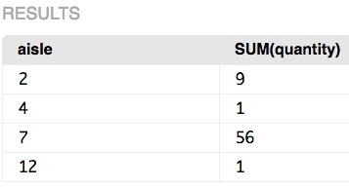

SELECT - GROUP BY

Slide 15
SELECT - GROUP BY HAVING
SELECT aisle, SUM(quantity)
FROM groceries
GROUP BY aisle
HAVING SUM(quantity) > 3;
Proč ne WHERE? Filtruje jednotlivé řádky před jejich předáním do GROUP BY.
Řádky tabulek -> WHERE -> GROUP BY -> HAVING -> ORDER BY -> LIMIT.

Slide 16
SELECT - ORDER BY, LIMIT
SELECT * FROM groceries ORDER BY aisle LIMIT 3;
SELECT * FROM groceries ORDER BY aisle LIMIT 1, 3;
SELECT * FROM groceries
ORDER BY aisle ASC, quantity DESC;

Slide 17
SELECT - funkce, CASE IN
SELECT DATE("now");
SELECT … WHERE expire_date < DATE("now");
INSERT INTO … VALUES (DATE("now"), … );
CASE WHEN [condition] THEN [expression] ELSE [expression] END
nebo
CASE [expression] WHEN [value] THEN [expression] ELSE [expression] END

Slide 18
SELECT - Summary
SELECT
WHERE
AND/OR
ORDER BY
SUM, COUNT, MAX, MIN...
GROUP BY
JOIN
HAVING
CASE, IN
ORDER BY, LIMIT

Slide 19
UPDATE
UPDATE groceries SET quantity = 10 WHERE id = 1 LIMIT 1;
UPDATE groceries SET quantity = quantity - 1 WHERE name = "Cherries" LIMIT 1;

Slide 20
ALTER TABLE
ALTER TABLE groceries ADD COLUMN expiration INTEGER;
ALTER TABLE groceries DROP COLUMN expiration;
ALTER TABLE distributors ADD CONSTRAINT distaddr FOREIGN KEY (address_id) REFERENCES addresses (id);

Slide 21
DELETE
DELETE FROM groceries WHERE id = 4 LIMIT 1;

Slide 22
Best practices
Psát příkazy velkými písmeny
Komentáře: /* comment block */ nebo -- comment line
Pro jistotu do UPDATE a DELETE přidávat LIMIT 1
Dbát na čitelnost - i u SQL ve zdrojových kódech
Notes:
Co tu bude: komentáře, příkazy velkými písmeny, nějaké rozumné formátování delších příkazů (hlavně SELECT)

Slide 23

COFFEE BREAK :)

Slide 24
ADVANCED SQL

Slide 25
ACID, TRANSAKCE
SELECT balance FROM accounts WHERE id = 111;
UPDATE accounts SET balance = balance - 10 WHERE id = 111;
UPDATE accounts SET balance = balance + 10 WHERE id = 222;

Slide 26
ACID, TRANSAKCE
Atomicity: transakce se provede zcela nebo vůbec (all or nothing)
Consistency: databáze se nedostane do neplatného stavu (porušení constraints apod.)
Isolation: paralelní transakce jsou od sebe oddělené, stejně jako kdyby se aplikovaly jedna za druhou
Durability: jakmile je potvrzen commit transakce, nemůže se transakce “ztratit” ani náhlým vypnutím serveru.
BEGIN;
SELECT balance
FROM accounts
WHERE id=111;
UPDATE accounts
SET balance=balance-10
WHERE id=111;
UPDATE accounts
SET balance=balance+10
WHERE id=222;
COMMIT;

Slide 27
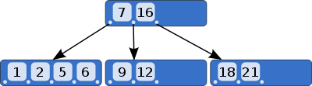
INDEXY
CREATE INDEX groceries_aisle ON groceries (aisle);

Slide 28
PROCEDURY, VIEWS
-- Function increments the input value by 1 CREATE OR REPLACE FUNCTION increment(i INT) RETURNS INT AS $$ BEGIN RETURN i + 1; END; $$ LANGUAGE plpgsql; -- An example how to use the function (Returns: 11) SELECT increment(10);

Slide 29
PRAKTICKA UKAZKA

Slide 30
SQL v Pythone
Standardizované DB-API (PEP 249) - tzn. stejně se používají i ostatní databáze (PostgreSQL, MySQL, …):
import sqlite3 conn = sqlite3.connect('example.db')
c = conn.cursor()
c.execute('SELECT * FROM stocks WHERE symbol=?', 'RHAT') print(c.fetchall())
conn.commit()

Slide 31
Anketa - priklad
Datovy model
SQL prikazy
Walk-though - template code (s bootstrap)
https://github.com/messa/db-workshop-web-app

Slide 32
FLASK
http://flask.pocoo.org/ - web microframework
from flask import Flask app = Flask(__name__) @app.route("/") def hello(): return "Hello World!" if __name__ == "__main__": app.run()
$ pip install Flask $ python hello.py * Running on http://localhost:5000/

